Slide 1


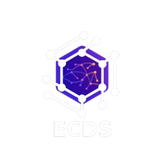


ECDS
MediSynC
DevÉlan.

Slide 2
ECDS
GUIDELINES
GitHub Submission: Submit your GitHub repository 8 hours before final evaluation.
Deployment: Deploy the complete project repository (frontend deployment optional).
Plagiarism Check: All submissions will undergo plagiarism verification.
Pitch Format: Round 1 & Round 2 will include a 7-minute project pitch + evaluation.
Team Requirement: Minimum 3 team members must be present during evaluation.

Slide 3
ECDS
Chronic Care Engagement Agent
Effective management of chronic conditions—specifically Diabetes, Hypertension, Chronic Kidney Disease (CKD), and Hypothyroidism—relies on consistent clinical monitoring (e.g., HbA1c, blood pressure, and renal function tests) to prevent rapid, silent physiological decline.Hospitals currently lack an automated, clinically-intelligent system to bridge the gap between available patient data and proactive intervention. This results in high-risk chronic patients 'falling through the cracks,' progressing silently from manageable conditions to costly, life-threatening emergency admissions due to unmonitored care gaps.

Slide 4
ECDS
OUR SOLUTION
MediSynC is an AI-driven proactive healthcare platform that continuously monitors patient health records to identify gaps in chronic disease care before they become serious complications. The system analyzes patient data daily, detects overdue tests or abnormal results, and automatically sends empathetic, personalized WhatsApp messages through Twilio in the patient’s preferred language. Patients can directly respond to schedule home test collections or seek clarification, enabling seamless interaction without visiting the hospital. The platform integrates web and mobile applications built with Flutter and a centralized database on MongoDB, ensuring doctors, hospitals, and patients stay connected through a single intelligent healthcare ecosystem.

Slide 5
ECDS
INNOVATION
MediSynC introduces a proactive AI care agent that continuously monitors patient health data, detects care gaps early, and engages patients through empathetic, multilingual WhatsApp communication powered by Twilio.
USP
Unlike traditional systems, MediSynC combines AI monitoring, automated outreach, and a shared ecosystem across web and mobile apps built with Flutter and MongoDB, turning passive hospital records into an active, patient-engagement platform.

Slide 6
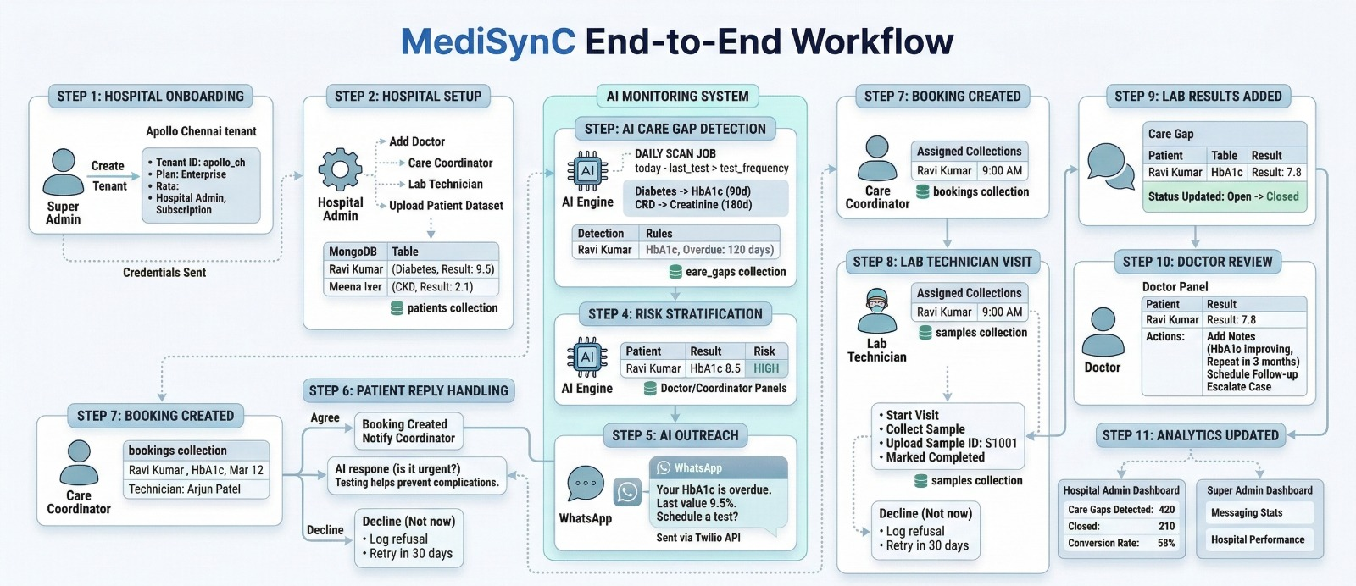
ECDS
WORKFLOW DIAGRAM

Slide 7
ECDS
TECH STACK
Frontend : HTML , CSS , JS
Backend : Django , DjangoREST Framework
Database : MongoDB , sqlite
LLM : Llama-3.1-8b-instant
Messaging : Twilio (Whatsapp)
Background Processing : Celery , Redis
App development : Flutter

Slide 8
ECDS
TEAM MEMBERS
1. Deepak P – Frontend & agent analysis
2. Jagan S – Backend & database
3. Sunny Joseph A – Ai & messaging services

